Slide 1
ENEON first workshop
Observing Europe: Networking the Earth Observation Networks in Europe
21-22 September, Paris
Global Terrestrial Network – Hydrology (GTN-H)
- Hydrological Networks in Europe -
Wolfgang E. Grabs (grabs@bafg.de)

Slide 2
Questions to be answered by your network (1/3)
About your network
1.1 Introduction: Representing as coordinator the Global Terrestrial Network – Hydrology (GTN-H) that is governed by WMO (GCOS and Hydrology Programme) . Aside from the global aspect of GTN-H, specifically major hydrological networks in Europe are highlighted.
1.2 Users: As estimated, several thousand users, individual, institutional, governmental, national and international organizations
1.3 Purpose: Provide improved access to hydrometerological data and information, worldwide through the federated data enters of GTN-H
1.4 Resources: Cost of maintaining the partner networks vary, depending on the operations and staffing of the data centers. The Global Runoff Data Centre, for example is funded with 800.000 EURO per year. Funding sources are usually national governments for each of the federated data centers with a long-term commitment
1.5 Challenges: In general, there are no major problems keeping GTN-H running

Slide 3
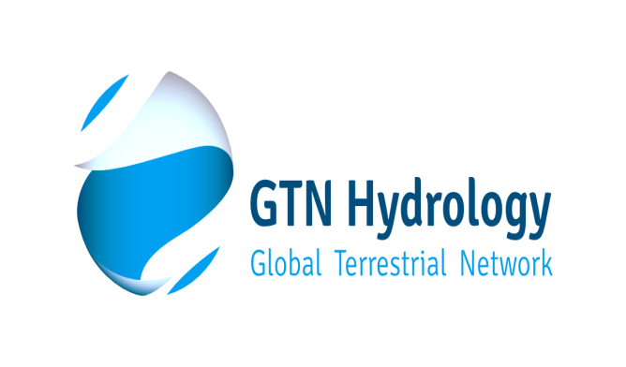
About GTN-H
Links existing networks and systems for integrated observations of the global water cycle
Established in 2001
“Network of Networks” for global and regional climate and water applications

Slide 4
Goals of GTN-H
Maintaining a global hydrological network of networks
Plans and implements projects that facilitate access to hydrological networks and observation data, and generates derived products
Forms an essential component for integrated global and regional hydrological products

Slide 5
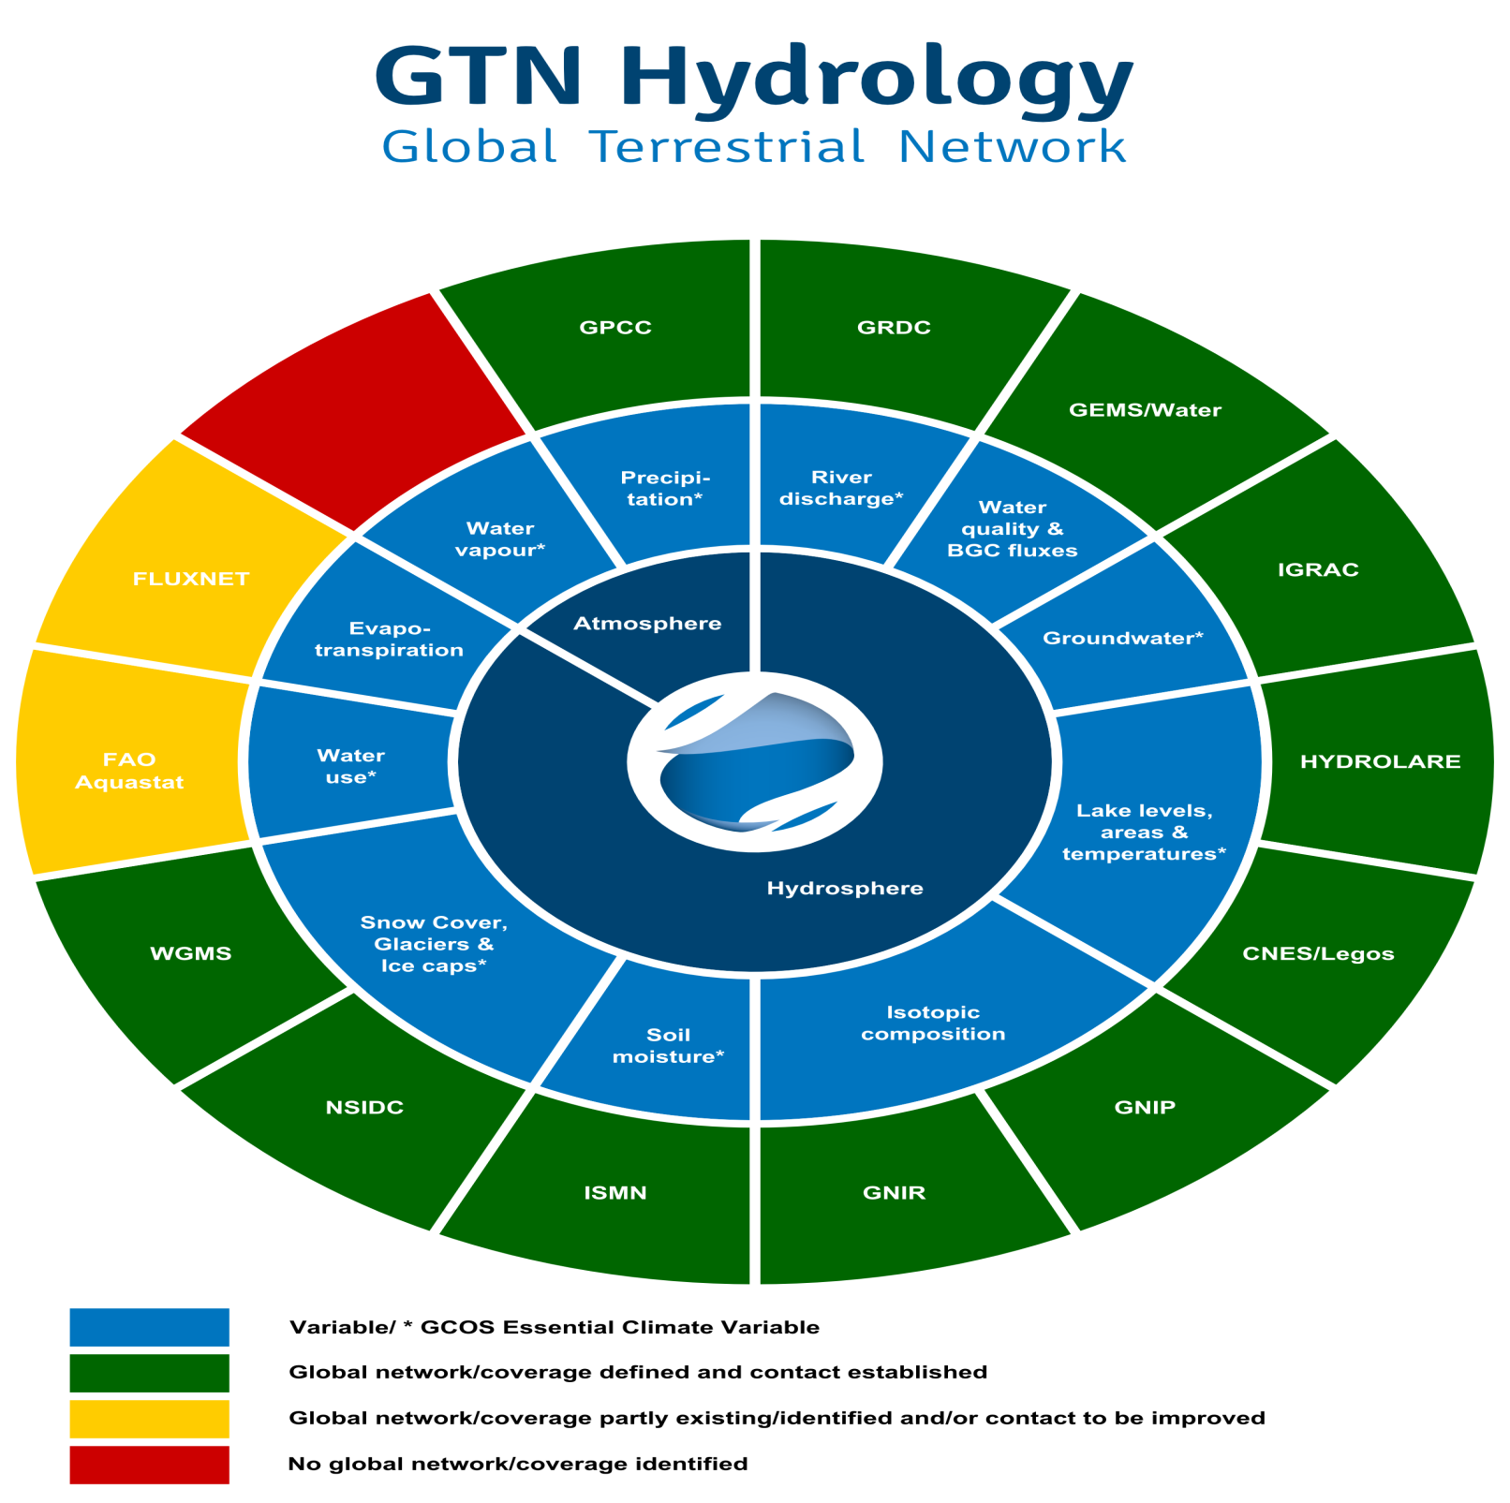
Configuration of GTN-H Network
Many global data centers are hosted by European partners!

Slide 6
International Context
Joint effort of the:
World Meteorological Organization/Climate and Water Department (WMO/CLW)
Global Climate Observing System (GCOS)
Global Terrestrial Observing System (GTOS)
Observational arm of the Group on Earth Observations/ Integrated Global Water Cycle Observations Community of practice (GEO/IGWCO-CoP)

Slide 7
Added value from GTN-H Federated Data Centres (Examples only)
[1] Products that improve our understanding of what’s available and how to access it (Management of Metadata, development of standards)
[2] Products that enhance baseline or core hydrological data and improve our knowledge of hydrology (Development of gridded runoff datasets)
[3] Products that result from the integration of existing datasets (i.e. Mapping of Biogeochemical Fluxes)
[4] Products that are designed to address specific science questions (i.e. reference hydrological data sets (pristine basins)

Slide 8
CHALLENGE:
Need to create a community of Support Partners to facilitate the development of integrated data and information products
(Reason: Resources at the level of global data centers are commonly not sufficient to also generate a wide range of science-based, user-driven data products)

Slide 9
Questions to be answered by your network (2/3)
2. About data
2.1 Hydrometerological data of “Essential Water Variables”, see GTN-H configuration
2.2 The network is global with varying time-steps that depend on the data collection scheme of the federated networks (i.e. hourly – monthly) Major limits are the density of networks and the number of reporting stations
2.3 Centers have data policies. In general data is shared to registered users free of charge.
2.4 Centers have quality management standards. The QC procedures are currently being compiled to obtain a general overview of QC practices of centers.
2.5 In several instances, metadata need to be completed including bathymetry data for lakes and reservoirs and river geometry.
2.6 The centers use various interface standards. There is a strong move towards standardization in cooperation with the Open Geospatial Consortium (OGC), i.e. with regard to the introduction of Water ML-2.
2.7 All federated data centers strive to upkeep continuity of data acquisition.

Slide 10
User Needs and Essential Water Cycle Variables (EWVs)
Developed by (1) GEO-UIC-SBA-Water (2010) & GEOSS Water Strategy Report CoP—(2015)
Through review process with wide acceptance by the community
EWVs are linked to applications and end-users. They are derived by reviewing/consolidating user-needs/requirements (for observations of water variables) in all GEO user sectors as defined by the GEO SBA’s
Community agreement reached by review (process) and consensus
EWVs are linked to international bodies (GEO and collaborating Member Organizations)
Data base with information on EWVs: Various, as maintained by national, regional and international organizations and programs. Source: Sushil Unninayar (NASA/GSFC-GESTAR)
)

Slide 11
Definitions: Essential Water Variables (EWV) are defined as water variables/parameters that address “user”-defined critical requirements for one or more of the following:
(1) Observational “monitoring” of key elements of the global and regional/local water cycle,
(2) Observations required by diagnostic and/or land surface/hydrological prediction models that are used to generate derived products for the end-user communities, and
(3) Observational and model-derived variables and parameters required by users of water data/information products as applied to various inter-disciplinary decision support systems and tools.
Source: Sushil Unninayar (NASA/GSFC-GESTAR)

Slide 12
EWVs
PRIMARY
Precipitation
ET
Snow Cover (& Depth, Freeze/Thaw Margins..)
Soil Moisture/Temp
Ground Water
Runoff/Streamflow/River Discharge
Lakes/Reservoir Levels and Aquifer Volumetric Change
Water Quality
Water Use/Demand (Agro, Hydro, Energy, Urban,…)
Glaciers/Ice Sheets
Source: Sushil Unninayar (NASA/GSFC-GESTAR)

Slide 13
Questions to be answered by your network (3/3)
3. About a network of networks
3.1 Interfaces exist mainly with national networks as well as through the GEO-Portal and the Portal of WMO’s Integrated Global Observing System (WIGOS)
3.2 In the European context, interfaces would desirable with EEA and perhaps through COPERNICUS mechanisms
3.3 In principal, GTN-H and its federated data centers could benefit from the existence of an ENEON or a similar network
3.4 From your point of view how this network of network should be managed? Need to know more about its functions and management
3.5 GTN-H is the observational component of the GEO Integrated Global Water Cycle Observations – Community of Practice (IGWCO-CoP)

Slide 14
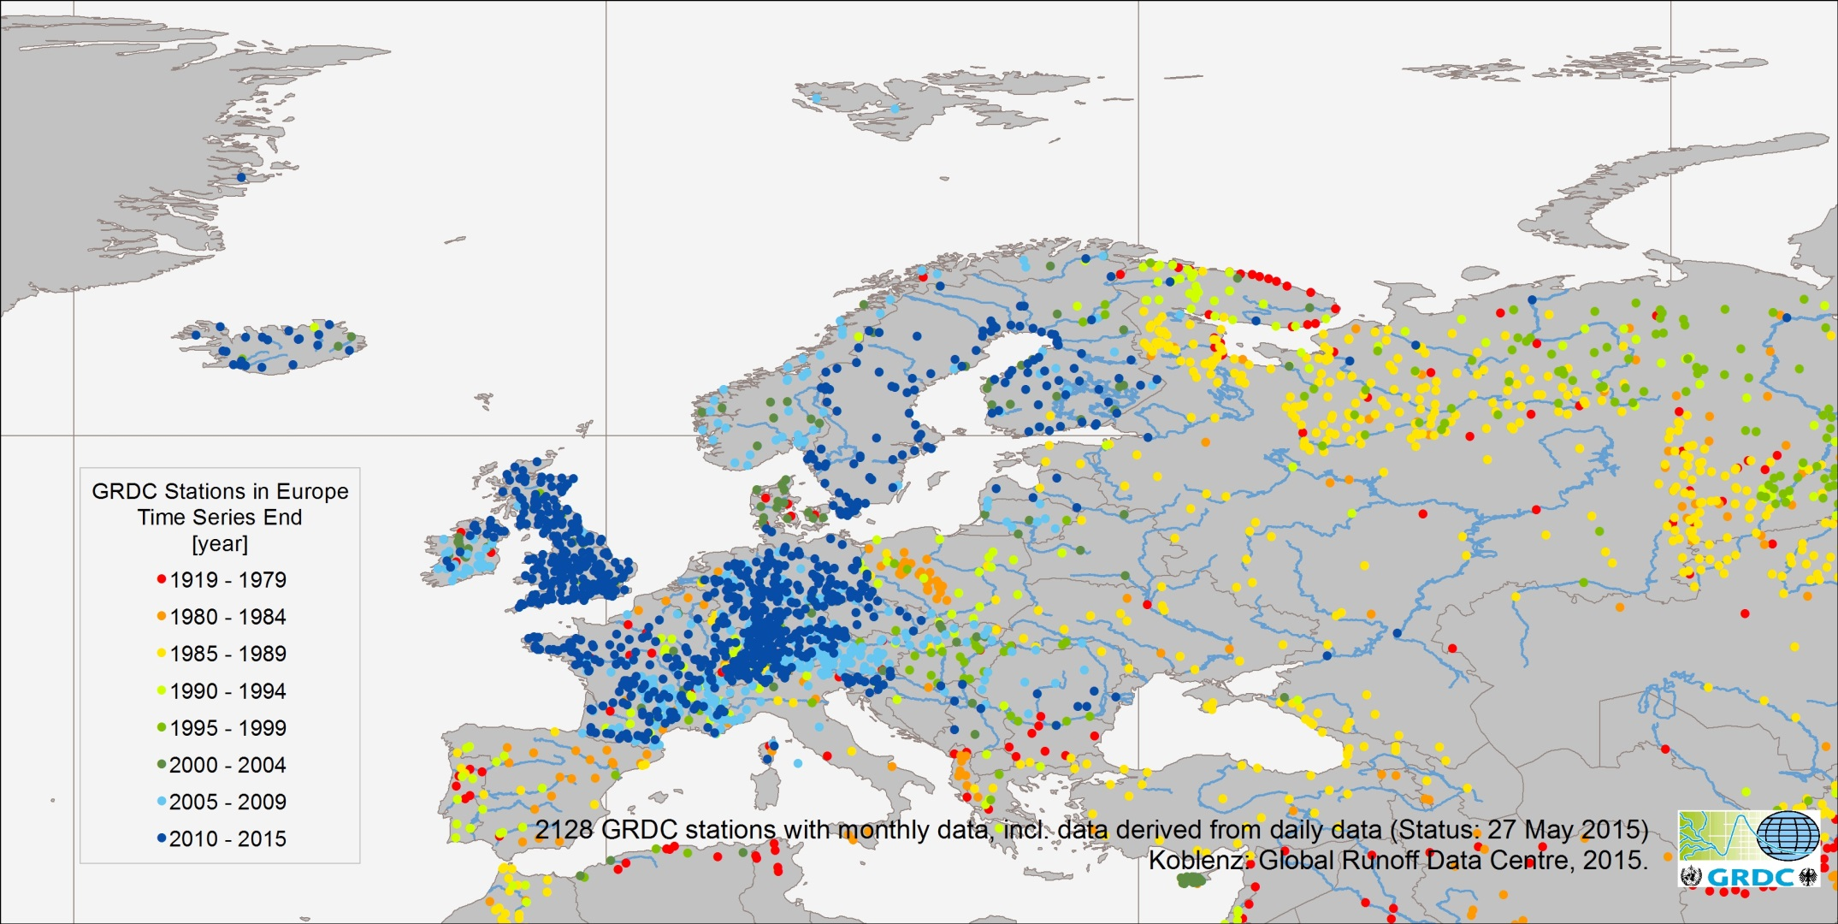
GRDC Stations for WMO RA VI - Europe

Slide 15
Availability of European river discharge stations at the GRDC on country basis
Country | Number of Stations | Latest data available | Country | Number of Stations | Latest data available | Country | Number of Stations | Latest data available
Albania | 9 | 1984 | France | 297 | 2012 | Macedonia | 1 | 1990
Armenia | 2 | 1982 | United Kingdom | 238 | 2013 | Netherlands | 10 | 2013
Austria | 73 | 2009 | Georgia | 8 | 1987 | Norway | 52 | 2008
Azerbaijan | 4 | 1987 | Greece | 11 | 1995 | Poland | 51 | 1997
Belgium | 3 | 1979 | Croatia | 2 | 1990 | Portugal | 16 | 1991
Bulgaria | 15 | 1999 | Hungary | 19 | 1999 | Romania | 19 | 2010
Belarus | 5 | 2002 | Ireland | 48 | 2010 | Serbia | 9 | 2010
Switzerland | 95 | 2012 | Israel | 7 | 1993 | Russian Federation | 381 | 2011
Cyprus | 14 | 2003 | Iceland | 24 | 2014
Czech Republic | 14 | 2012 | Italy | 25 | 2008 | Sweden | 81 | 2013
Germany | 326 | 2013 | Jordan | 3 | 1988 | Slovenia | 26 | 2012
Denmark | 21 | 2015 | Lithuania | 12 | 2009 | Slovakia | 23 | 2008
Estonia | 4 | 1987 | Luxembourg | 2 | 1987 | Syria | 4 | 1979
Spain | 37 | 1999 | Latvia | 5 | 2013 | Turkey | 28 | 1987
Finland | 78 | 2012 | Moldova | 2 | 1987 | Ukraine | 24 | 1995

Slide 16
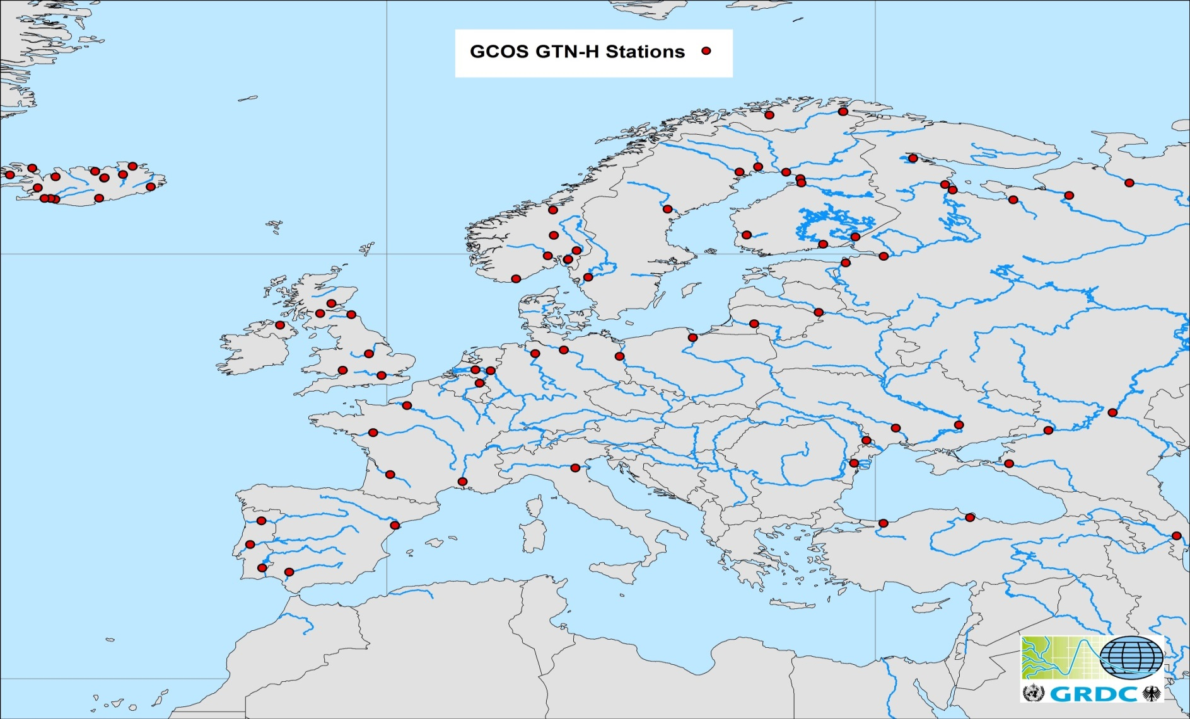
Global Terrestrial Network for Hydrology (GTN-R) stations for WMO RA VI - Europe

Slide 17
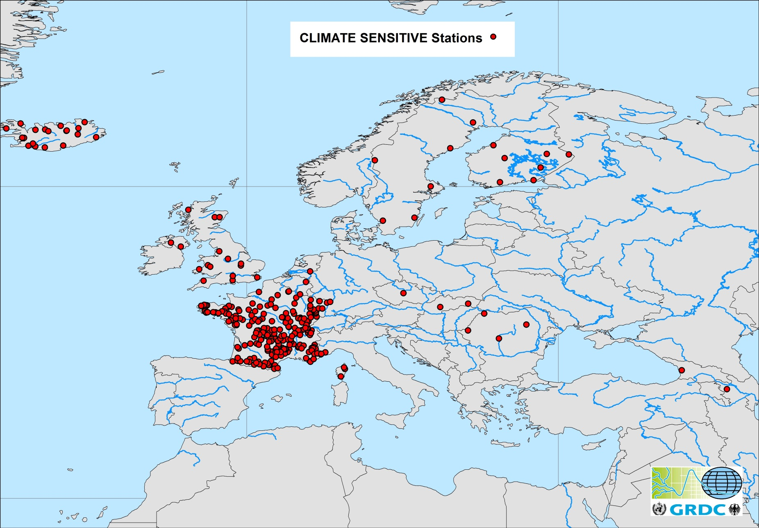
Climate Sensitive Stations for WMO RA VI - Europe

Slide 18
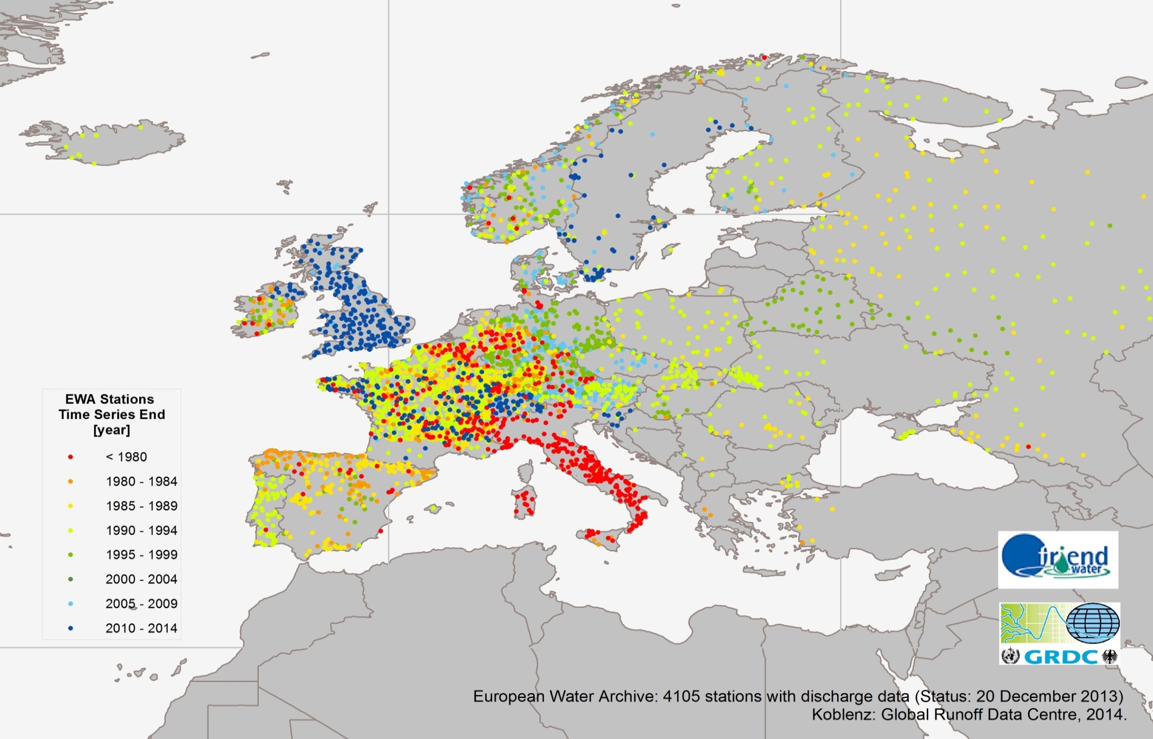
European Water Archive of the UNESCO –EURO-FRIEND-Water Programme maintained by the GRDC

Slide 19
EFAS – Example of a Specialized Network

Slide 21
2015: New Tender for data collection over 6 years (Hydrology/Meteorology, real-time networks!)

Slide 22
Waterbase - Transitional, coastal and marine waters
http://www.eea.europa.eu/themes/water/dc
Waterbase is the generic name given to the EEA databases on the status and quality of Europe's rivers, lakes, groundwater bodies and transitional, coastal and marine waters, and on the quantity of Europe's water resources.
Data collected through the WISE-SoE data collection process are from statistically stratified monitoring stations and groundwater bodies and are comparable at the European level. Waterbase data are primarily used in the production of the EEAs indicator-based factsheets.

Slide 23
Thank you for your attention!

